Slide 1
ECON3086
Python Programming for FinTech
Team I
22 April, 2026
aperture
aperture
aperture
aperture
aperture
Ginni Vishal 22203133
Fung Dao Wen 22230467
SADIEV Sherzodbek 22200959
Thit Htun LIN 23200073
THANT-THAZIN-EAIN 22202110

Slide 2
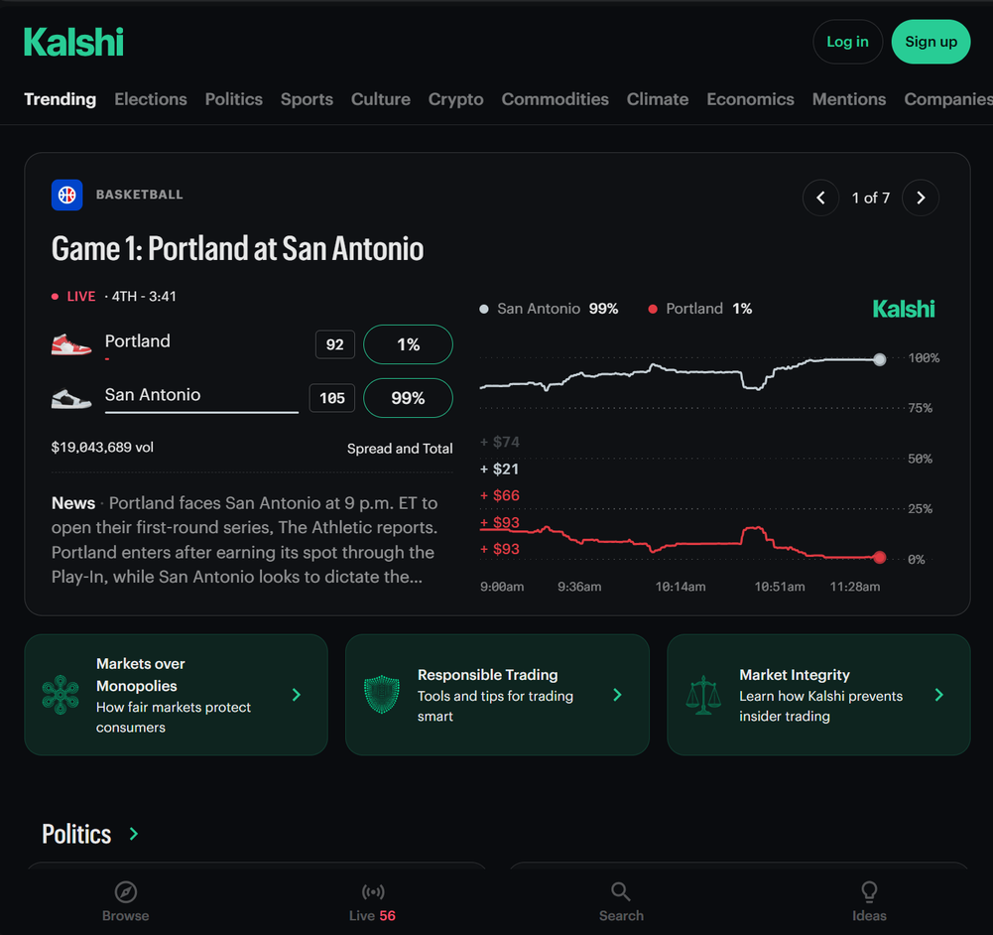
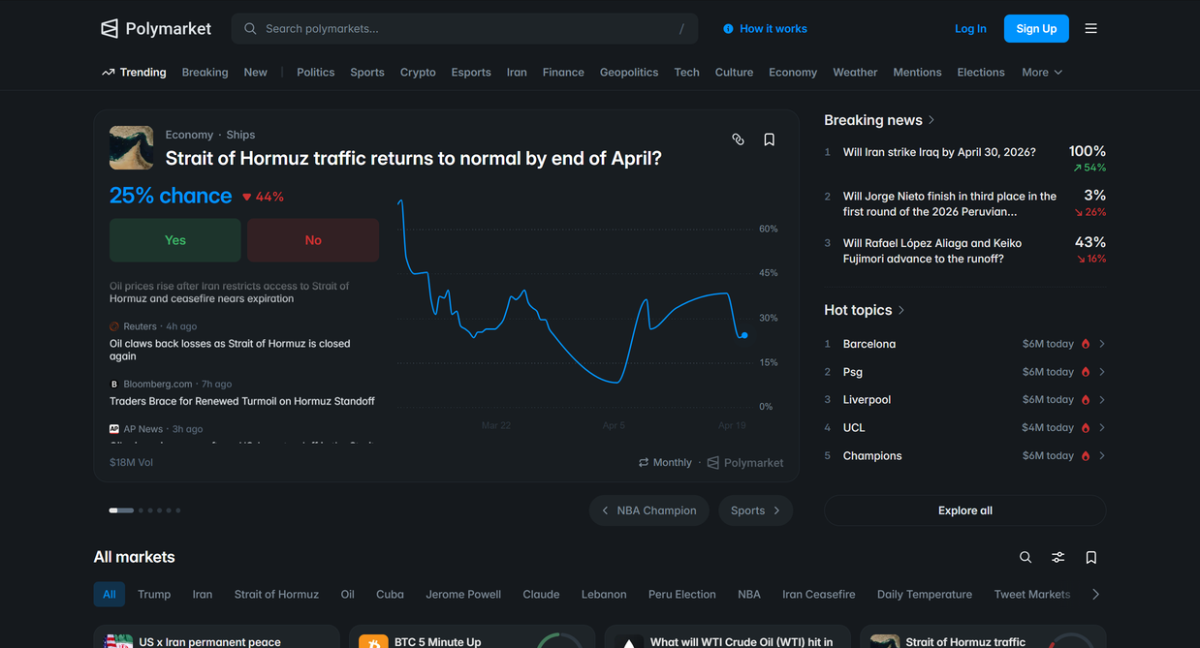
ECON3086
Python Programming for FinTech
Team I
22 April, 2026
Let’s Face It
Half of Polymarket is signal. Half is vibes. Traders can’t always tell which is which, and doing the research manually is slow and scattered.

Slide 3

PROBLEM
SPECULATIVE
RESEARCHABLE
"Will X meme coin 5x?"
"Will CPI print below X?"
"Will celeb Y pump token Z?"
"Will candidate A win state?"
"Will vibes flip by Friday?"
VS
"Will policy bill pass?"
✕ No public evidence base
✓ Evidence exists, but scattered
✕ Hard to ground
✓ News + filings + data sites
✕ Weak audit trail
✓ Tabs/screenshots don't scale
Prediction markets are not the gap.
The research workflow is the gap.
Aperture = structured + auditable + durable pipeline
not a one-shot black-box answer

Slide 4
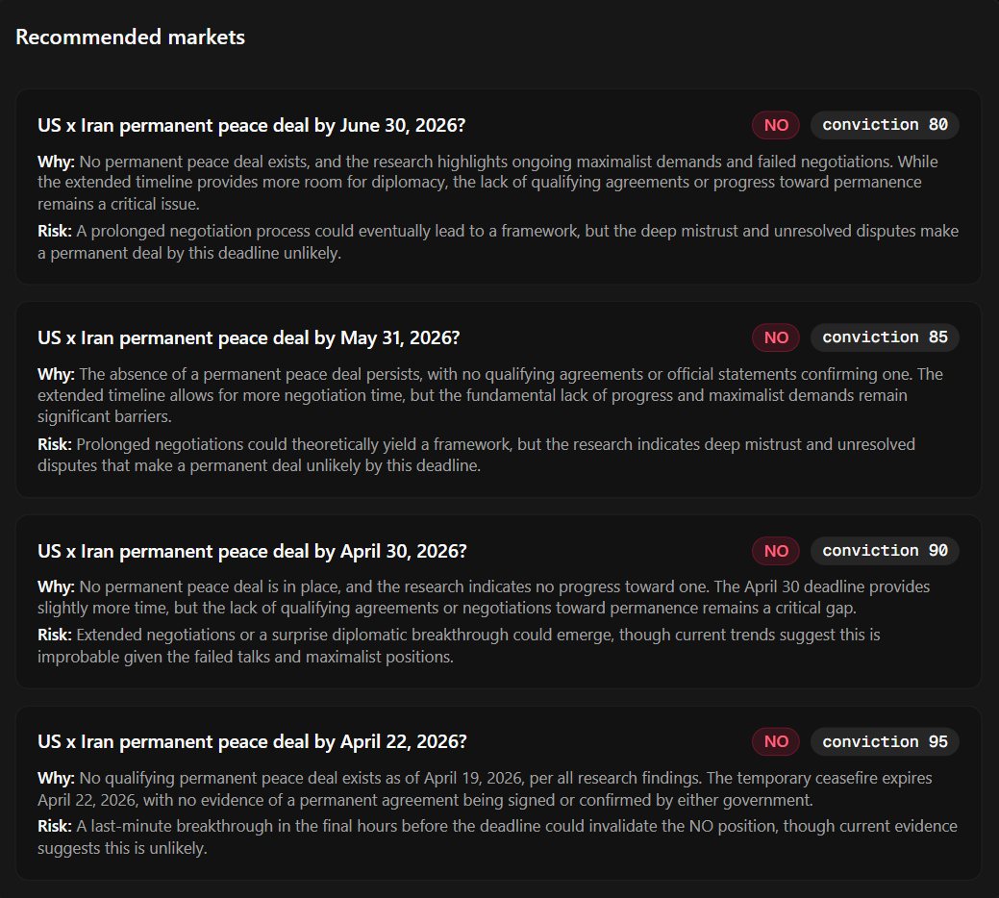
ECON3086
Python Programming for FinTech
Team I
22 April, 2026
Introducing
Aperture
A Convex‑native research agent that decides whether a Polymarket event is researchable and, if it is, produces a sourced memo and a suggested market and side, with every step persisted and resumable.
Classify
Plan
Search
Synthesize
Recommend

Slide 5
ECON3086
Python Programming for FinTech
Team I
22 April, 2026
User Experience
User Experience
User Experience
User Experience
User Experience
Ginni Vishal 22203133
Fung Dao Wen 22230467
SADIEV Sherzodbek 22200959
Thit Htun LIN 23200073
THANT-THAZIN-EAIN 22202110

Slide 6
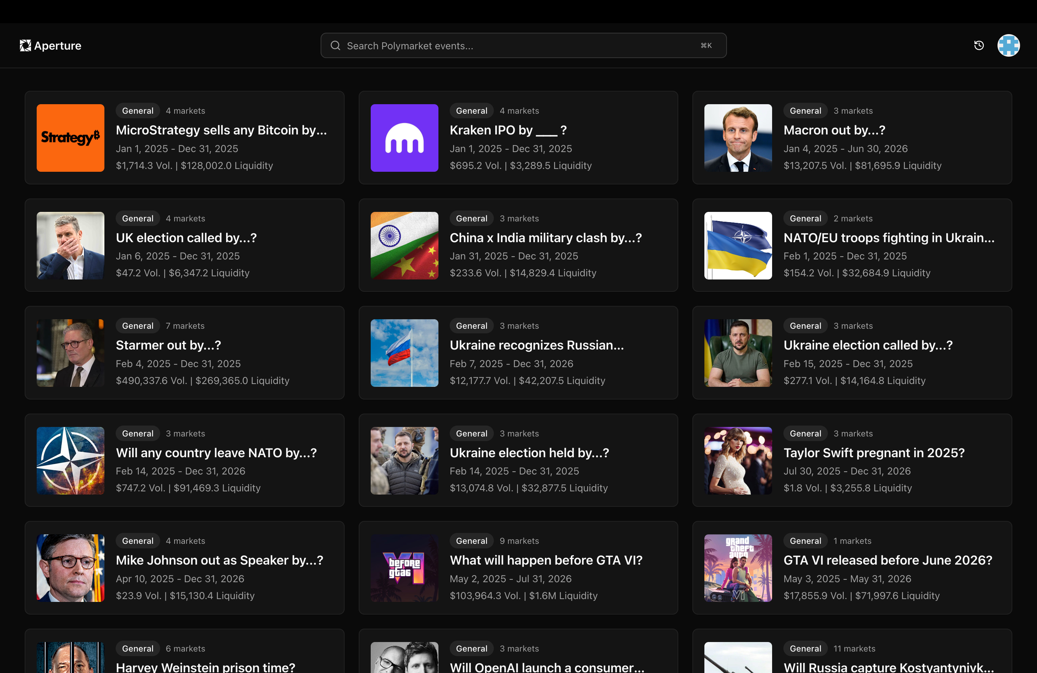
User Experience
22 Apr, 2026
How
Aperture
Works
Fast Scanning
Users compare multiple markets at a glance.
Relevant Context
Tags, dates, volume, and liquidity stay visible.
Low Friction Flow
Scan
Compare
Enter
Discovery leads directly into the event page.
Read the dashboard quickly.
Check market context.
Open the selected event.

Slide 7
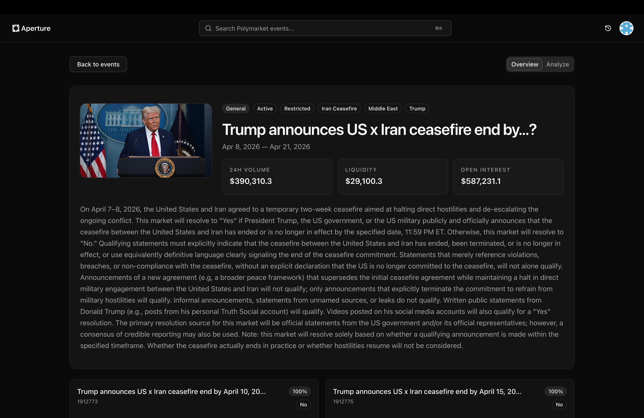
User Experience
Entering
the
System
Research-first
A structured interface for evaluating Polymarket events.
Event-centric
Each market opens into a dedicated event workspace.
Built for analysis
From discovery to evidence-based analysis.
Browse
Open
Analyze
Scan the market list.
Review the event page.
Move into deeper analysis.

Slide 8
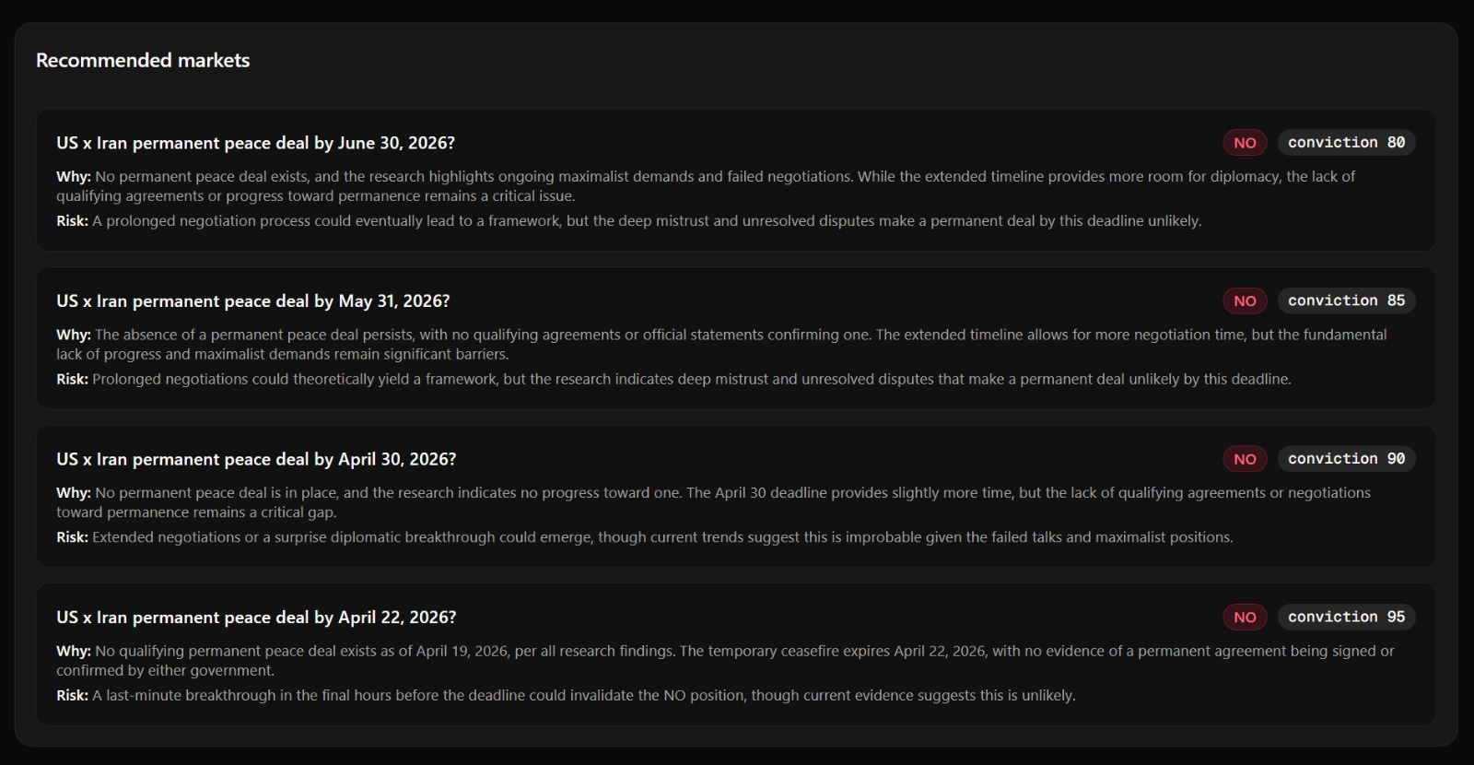
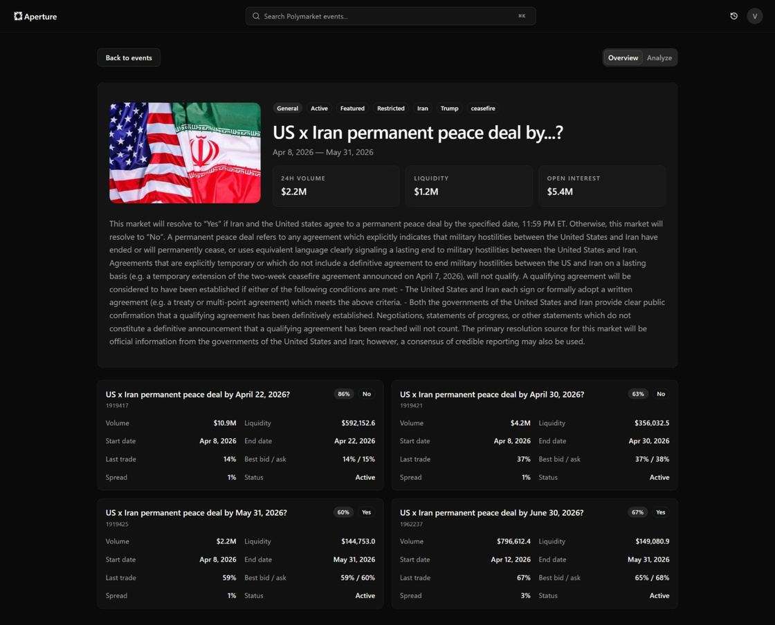
Click
Start Analysis
Convex Run
Update
Analyze the
Market
No WebSockets
No SSE route
Live DB UI

Slide 9
ECON3086
Python Programming for FinTech
Team I
22 April, 2026
Demo
Demo
Demo
Demo
Demo
Ginni Vishal 22203133
Fung Dao Wen 22230467
SADIEV Sherzodbek 22200959
Thit Htun LIN 23200073
THANT-THAZIN-EAIN 22202110

Slide 10
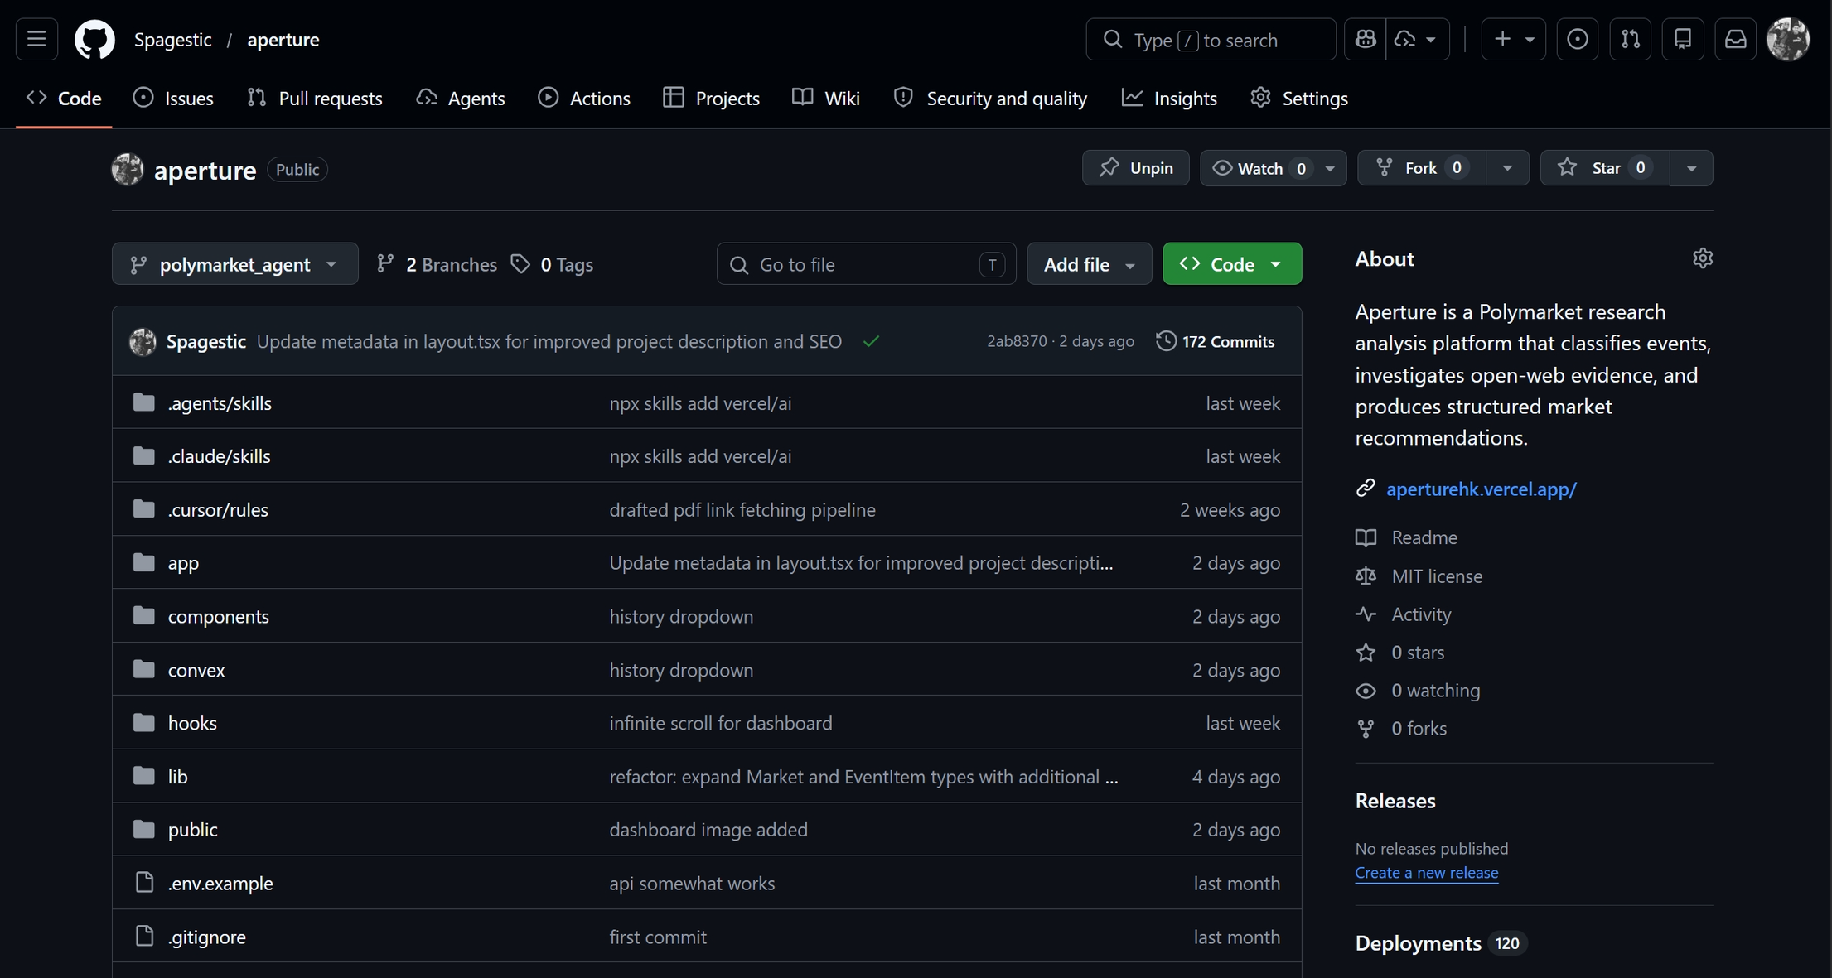

Slide 11
ECON3086
Python Programming for FinTech
Team I
22 April, 2026
Libraries & Tools
Libraries & Tools
Libraries & Tools
Libraries & Tools
Libraries & Tools
Ginni Vishal 22203133
Fung Dao Wen 22230467
SADIEV Sherzodbek 22200959
Thit Htun LIN 23200073
THANT-THAZIN-EAIN 22202110

Slide 12
What Tech Stack Does Aperture Use?
FRONTEND
RUNTIME / DB
AI / AGENT
Next.js App Router
Convex
AI SDK + Mistral
TypeScript
workflow
generateObject
shadcn / Tailwind
agent
Zod schemas
streamdown
reactive queries
structured output
DATA / TOOLS
EXTERNAL INPUTS
EXECUTION PATTERNS
Firecrawl search
Polymarket Gamma API
Promise.all fan-out
Firecrawl scrape
event + markets
per question parallelism
Convex actions
page metadata
single structured helper
RESEARCH_BUDGET
governs iteration caps / scrape caps
bounded cost & latency

Slide 13
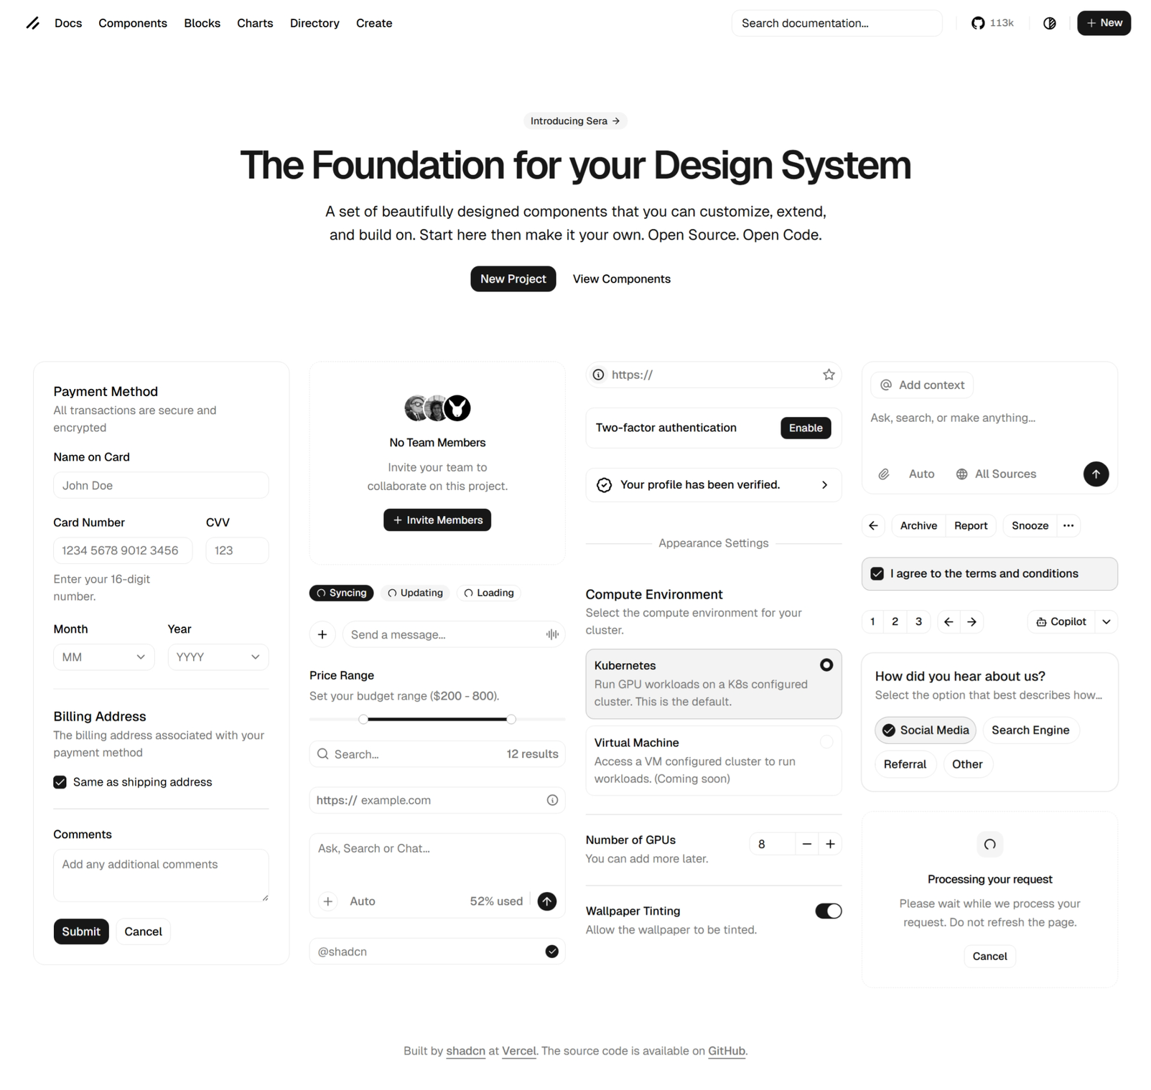
FRONTEND
Next.js App Router
TypeScript
shadcn / Tailwind
streamdown
For streamed markdown,
from general to specific

Slide 14
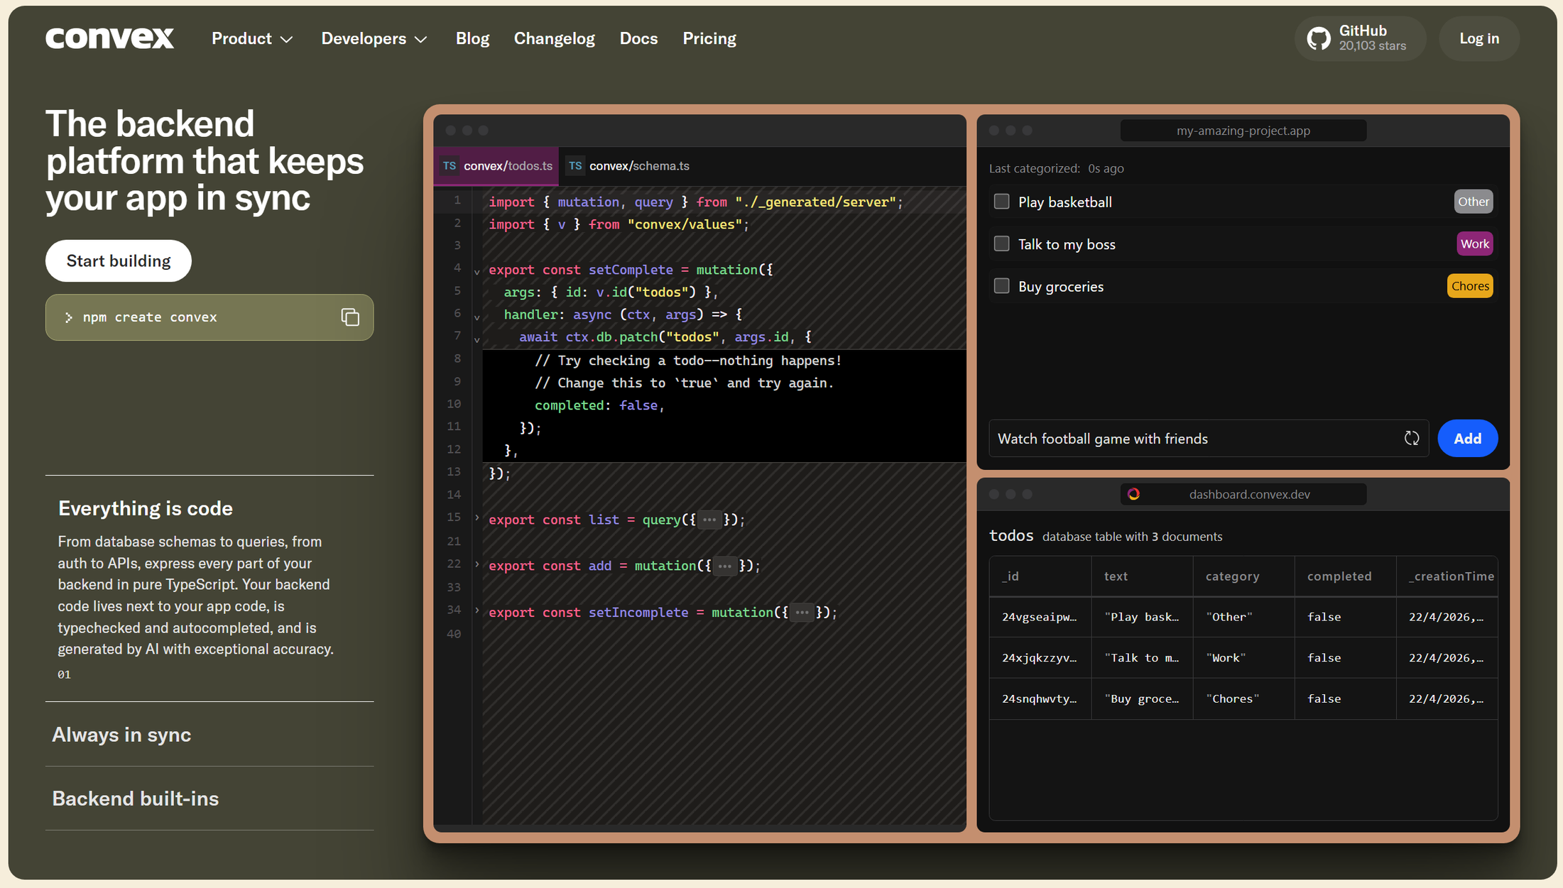

Slide 15
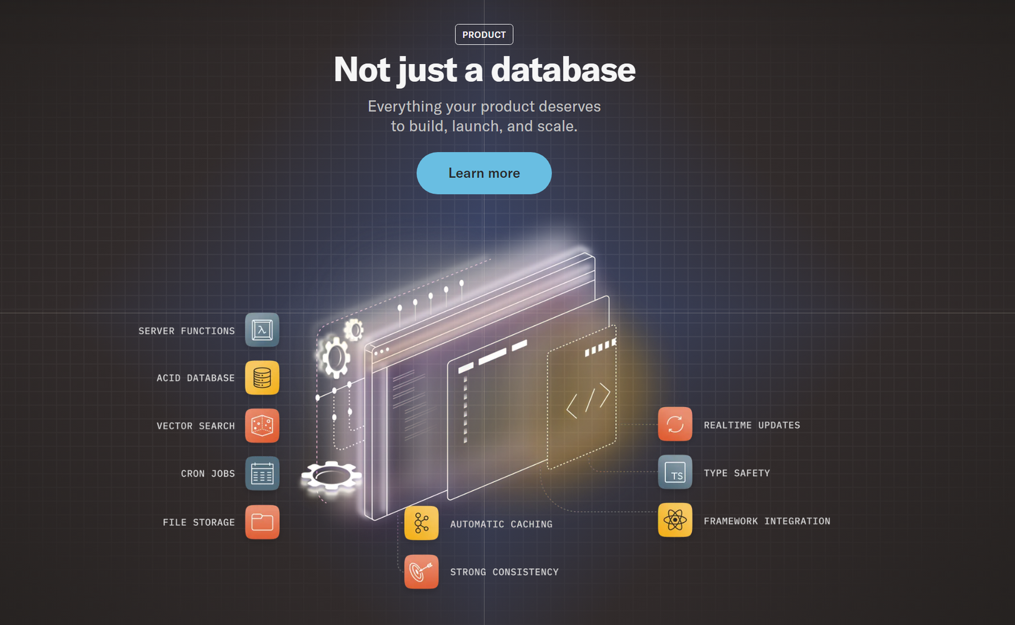
RUNTIME / DB
Convex
For durable steps with retries
workflow
agent
For persisted LLM threads
reactive queries
For replacing any streaming endpoint

Slide 16

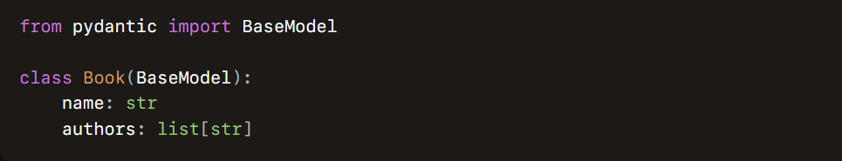

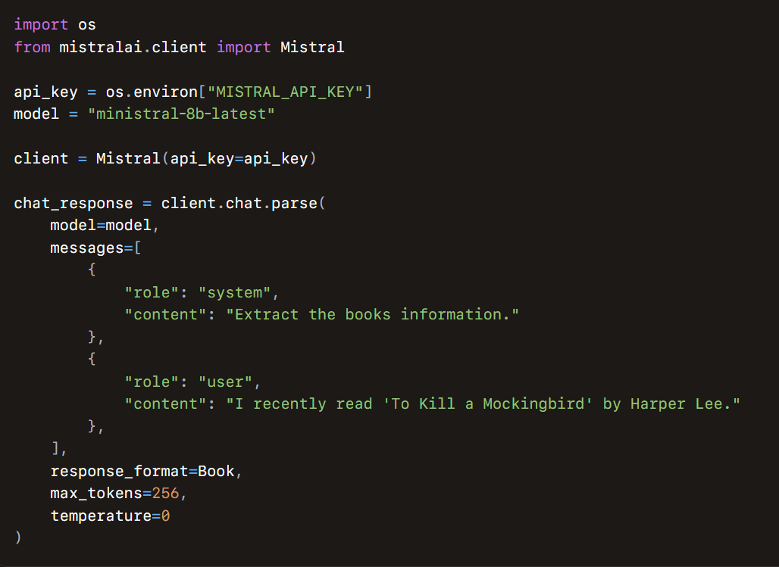
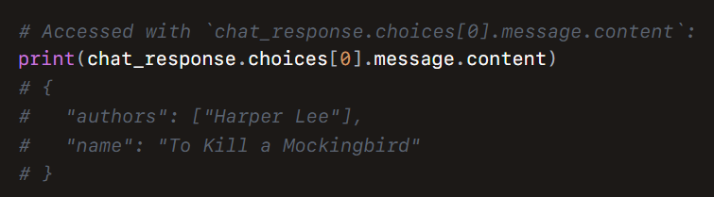

AI / AGENT
AI SDK + Mistral
generateObject
Zod schemas
structured output
Zod‑typed structured output
Classify
Judge
Summarize
Pick markets

Slide 17
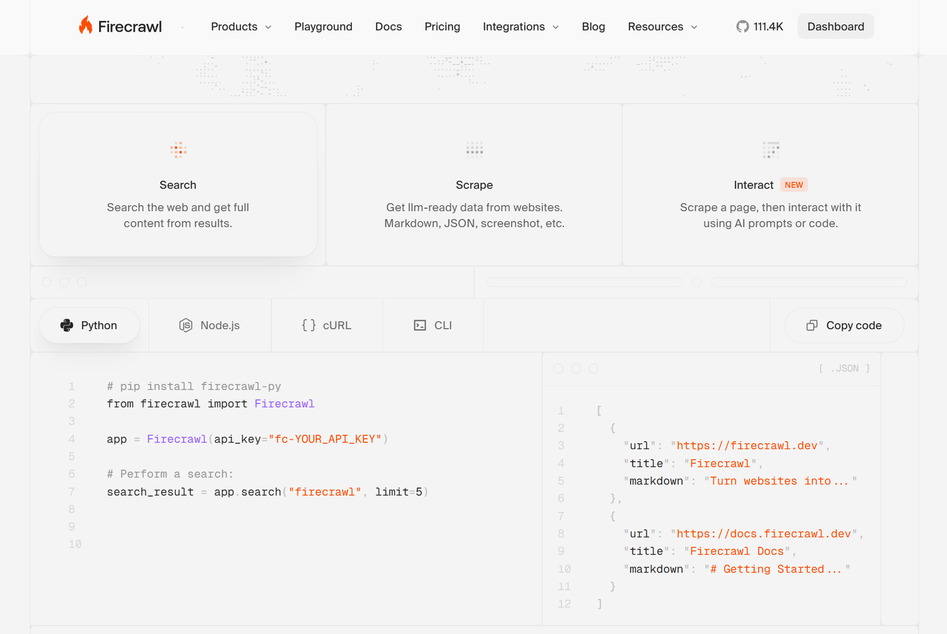
DATA / TOOLS
Firecrawl search
Firecrawl scrape
Convex actions
Leaf tools wrapped as Convex actions:
search for discovery
scrape for page content

Slide 18
Practical Uses of These Libraries &Tools
EXTERNAL INPUTS
EXECUTION PATTERNS
RESEARCH_BUDGET
Polymarket Gamma API
Promise.all fan-out
Constant governs iteration caps / scrape caps
event + markets
per question parallelism
page metadata
single structured helper
Bounded cost & latency
For fan‑out over questions and over scrape/summarize per question
Every LLM call goes through a single structured helper with a Zod schema.
For event + markets metadata on the page
Limited API credits

Slide 19
ECON3086
Python Programming for FinTech
Team I
22 April, 2026
COMPLEX LOGIC
COMPLEX LOGIC
COMPLEX LOGIC
COMPLEX LOGIC
COMPLEX LOGIC
Ginni Vishal 22203133
Fung Dao Wen 22230467
SADIEV Sherzodbek 22200959
Thit Htun LIN 23200073
THANT-THAZIN-EAIN 22202110

Slide 20
How Does the System Handle Complex Flows?
(1) SPECULATIVE FILTER AS GATE
{ isSpeculative, reason }
A single decision short‑circuits the whole workflow
(2) SUPERVISOR / SUB-AGENT LOOP
search → LLM judge (picks URLs to open (indices + reasons)) → scrape → summarize/relevance → refine
stop if relevantCount >= target OR iteration >= 3
Every transition is a row patch, so the UI shows progress without extra plumbing
(3) DURABILITY + AUDITABILITY
step.runAction per phase
retries on transient failure
full trail persisted in DB tables
pseudocode
Refreshing the page resumes the same run
if speculative: stop(reason)
qs = plan(event)
for q in parallel: research(q, budget=3)
answers = consolidate(qs)
picks = map_to_markets(answers, markets)
memo = synthesize(answers, picks)
(4) MARKET MAPPING
Map evidence → actual Polymarket market → produce a side + 0 - 100 conviction + rationale + key risk
The synthesizer doesn’t just pick YES/NO

Slide 21
Limitations
22 Apr, 2026
(1) WHAT WE SHIPPED
auth-gated runs + per-user ownership + cancel button
Wired directly to workflow cancel.
Extras & Limitations
debug log feed (researchLogs)
Transparent live view during the demo.
modular UI — analyze-panel/ split
Empty state, run header, memo, picks, question timeline, logs.
(2) WHAT WE DIDN'T
bounded by Firecrawl recall + LLM judgment
Paywalled or very recent sources can be missed.
research assistant — not trading advice
No execution; the user still makes the call.
budget caps can exhaust before evidence converges
Some questions end with insufficient public evidence.
(3) WHAT'S NEXT
backtesting on resolved markets · recency-weighted scoring · citation-level UI · chat-with-this-memo via reused threads

Slide 22
Wrap-up
22 Apr, 2026
Classify
Aperture
Plan
scattered web evidence → a durable, reactive research workflow.
Search
We turned Polymarket event data and open-web sources into a pipeline that classifies the event, cites its sources, and recommends a market and a side.
Synthesize
Recommend
the loop, end to end

Slide 23
ECON3086
Python Programming for FinTech
Team I
22 April, 2026
thank you
thank you
thank you
thank you
thank you
Ginni Vishal 22203133
Fung Dao Wen 22230467
SADIEV Sherzodbek 22200959
Thit Htun LIN 23200073
THANT-THAZIN-EAIN 22202110

